Slide 1
Advance Java
Java Beans and JSP Actions
LEVEL – PRACTITIONER

Slide 2
About the Author
Created By: | Renjith(t-renjith)/ Shanmu (105110)
Credential Information: | Trainer / Sr Architect
Version and Date: | 1.0, January 16’th 2012
Cognizant Certified Official Curriculum

Slide 3









Icons Used
Hands on Exercise
Questions
Tools
Coding Standards
Test Your Understanding
Case Study
Best Practices & Industry Standards
Demonstration
Workshop

Slide 4
Objectives
After completing this chapter you will be able to understand:
What is a java bean?
What is JSP action tag?
Type of JSP action tags.
How to use JSP action tags?

Slide 5
What is server side java bean ?
A server side java bean is a class used to store the details of real world entities
Example: Employee → Employee Name and Employee Salary,
Student → Student Name, Student Address.
Bean is a plain java class which contains
Fields (or) Properties: Fields to store the data, example: Employee Name, Salary.
Methods: Methods for retrieving and modifying the attributes like setEmployeeName(), setStudentAddress(). The methods are referred to as accessors/mutator.

Slide 6
Java Bean design conventions
A JavaBean component property can be read/write, read-only, or write-only.
The bean property needs to be accessible using public methods.
For each readable property, the bean must have a method as illustrated below to retrieve the property value
Syntax:
Public Datatype get<PropertyName> {
return value; // Returns the property value
}
Example:
Public int getEmployeeId {
return empId; // Returns the employee id value
}

Slide 7
Java Bean design conventions
For each writable property, the bean must have a method as illustrated below,
Syntax:
Public set<PropertyName>(Datatype newValue) {
property= newValue; // sets the new value into the property
}
Syntax:
Public setEmployeeId(int newEmpId) {
empId= newEmpId; // sets the new employee id into the employee id property
}

Slide 8
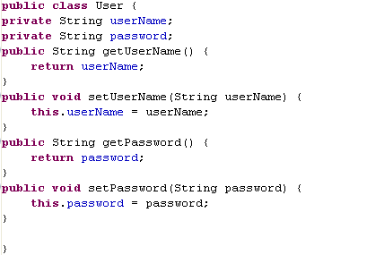
Sample Bean Class
The bean properties User Name and password.
Declared private.
Getter method for retrieving the user name. Declared Public.
Setter method for modifying user name. Declared Public.
Note the getter and setter names convention is
1. get + property name with the first letter of the property name capitalized
and
2. set+ property name with the first letter of the property name capitalized .

Slide 9
Why to follow naming convention for methods?
The web container maps the request attribute with the method names and triggers the appropriate methods for retrieving or setting the values.
Example:
Request Attribute Name: empId
Method Triggered: setEmpId(), getEmpId()
NOTE: Web container automatically capitalizes the first character of the attribute name and concatenates “set” (or) “get” to it for either setting or retrieving property values in bean.
How is this done?
This is done using reflection and introspection.
Reflection & introspection are java API’s used for finding the properties and methods of a class and invoking it dynamically.
Reflection is out of scope in CATP program. If interested trainees can explore this on their own.

Slide 10
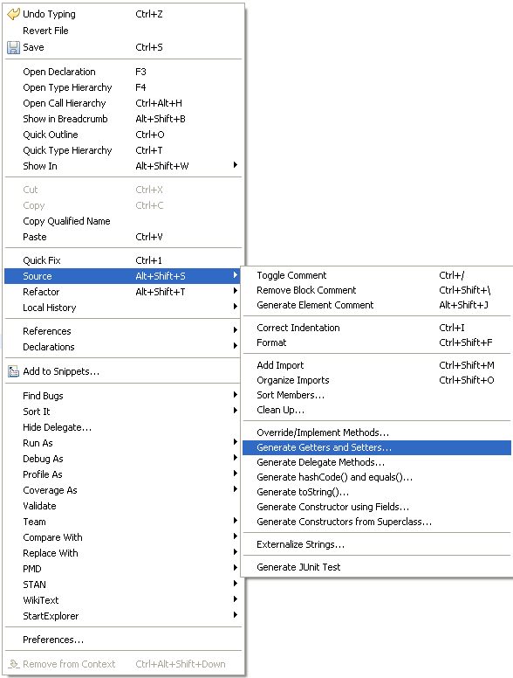
Easy steps for creating Beans using SDE
Step 1 : Create a class named User
Step 2 : Declare two properties for the class
userName – type String.
Password - type String.
Step 3 : Right click source →
source→ generate getter and setter

Slide 11
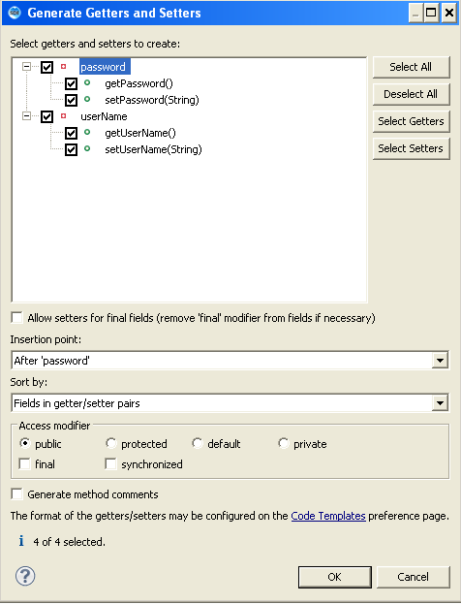
Easy steps for creating Beans using SDE (Cont)
Select the properties and the accessor methods to be generated and click Ok.

Slide 12
Need for Beans in JSP
Beans are used to JSP for collectively storing some information .
Beans makes transfer of data between JSP’s easier.
For example if you are handling with a registration form all the registration details can be loaded into a RegistrationBean and can be transported across other components as a single object.

Slide 13
Need for Beans in JSP
How to set value to a Bean ?
Values can be set to the bean using the setter method .
userBean.setName(request.getParameter(“name”));
Reads the parameter name from the request and sets it to the property name in userBean.
How to read values from a bean ?
Values can be retrieved from a bean using the getter method .
String userName=userBean.getName();
Reads the property value name from the bean and assigns it to a variable.

Slide 14
Lend a Hand : Using Java beans in JSP
In this demo we are going to familiarize how java beans are used with jsp.
We are going to develop a login page and validate the credentials and redirect the response to success or error page.
Components
1 . login.jsp : login page
2 . success.jsp : Success page
3 . User.java : The user bean class.
The login.jsp will validate the user name/password , create a user bean if successful redirect it to success page. Success page should access the bean properties and display it on the screen.

Slide 15
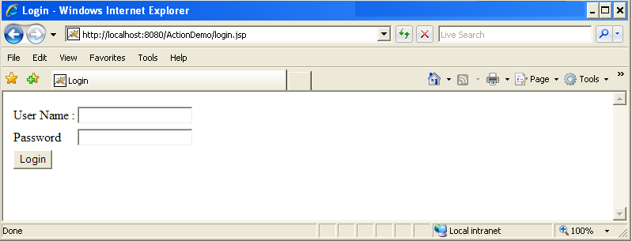
Lend a Hand – login.jsp
We will create a login page as shown below,
User Name – Text Field
Password – Password Field
Login - Submit button

Slide 16
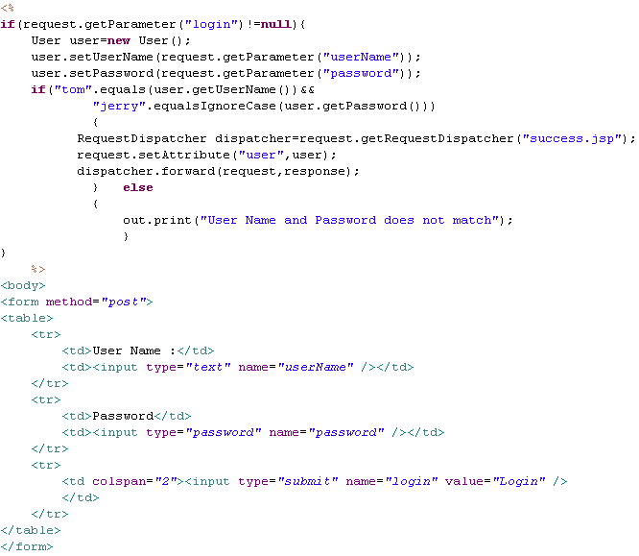
Lend a Hand – Develop login.jsp
Sets the values to the bean using the setter methods
Reads the values to the bean using the getter methods
Sets the bean as a request attribute

Slide 17
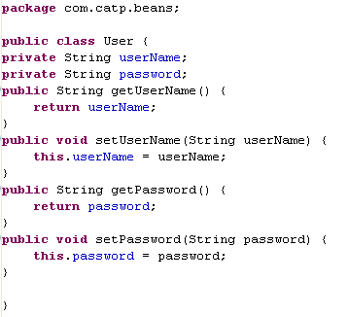
Lend a Hand – Develop user Bean
Develop the user bean as mentioned below.

Slide 18
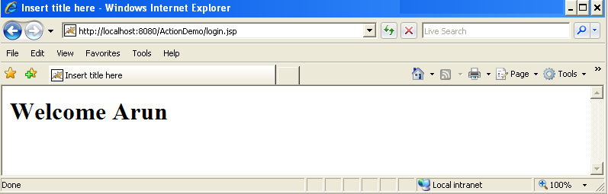
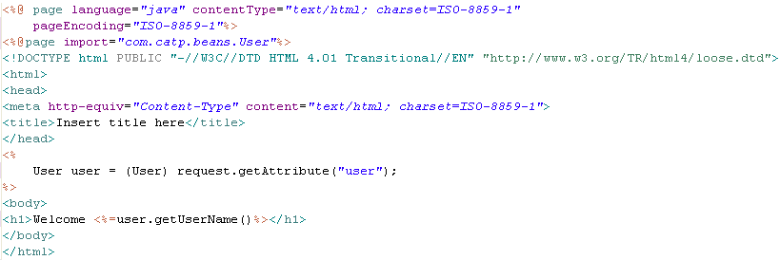
Lend a Hand – Develop success.jsp
Welcome TOM
Reads the bean object from request and type casts it.
Reads the username from the bean using getter method.

Slide 19
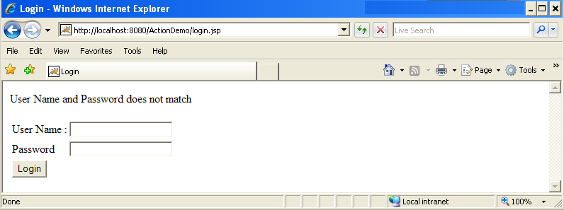
Lend a Hand – Invalid Login
In case of invalid login redirect the request to login page and display the error message.

Slide 20
Lend a Hand : Deploy and Run
Step 1 : Deploy and run the application
Step 2 : Call login.jsp from the browser
http://localhost:8080/ActionDemo/login.jsp
Step 3 : Enter user name and password as “tom” & “jerry” and click login. The success page should be displayed.
Step 4: Enter a invalid user name and password the control should be redirected to a error page.

Slide 21
What is JSP action tag ?
JSP action tags are a set of predefined tags provided by the JSP container to perform some common tasks thus reducing the java code in JSP.
Some of the common tasks are,
Instantiate java bean object.
Setting values to beans.
Reading values from beans.
Forward the request to another resource.
Including another resource.

Slide 22
jsp action tag syntax
<jsp:action_name attribute="value" />
Where,
action_name : specifies the name of the action to be performed
attribute : specifies the attributes relevant to the action.
Example:
<jsp:include page=“myPage.jsp” />
Where “include” is the action and “page” is the attribute of the action include, this performs the include action of including a JSP page.

Slide 23
Action tags in JSP
The following are the action tags available in JSP
jsp:include
jsp:forward
jsp:usebean
jsp:setProperty
jsp:getProperty
jsp:fallback
jsp:element
jsp:body
jsp:text
jsp:attribute
jsp:param
jsp:plugin
The highlighted ones will be covered in detail in the coming slides.

Slide 24

JSP:include
Used for dynamically including the pages
Includes the output of the included page during run time
Contents of the page are not included – Only the response is included.
Assume footer.jsp is included homepage.jsp
R
E
Q
U
E
S
T
R
E
S
P
O
N
S
E
5
The footer JSP response is included in the home page and response sent to client.
2
1
Home page translated to homepage.java by web container.
4
homepage.jsp
homePage_jsp.java
footer_jsp.java
3
Home page requests footer JSP file.

Slide 25
Jsp:include tag
Syntax :
<jsp:include page=“PageName” />
Example : Assume that the following line is included in index.jsp
<jsp:include page=“myPage.jsp” />
Here the myPage.jsp response is included in the index.jsp

Slide 26
Directive Vs Action include
Consider a scenario in which we are asked to create a login application . They have the following requirements
Home page is common for all categories of employees
The heading is different for different designation of employees and should be included in all the pages based on the employee designation
The footer page is common for all and should be include in all the pages .
Given the above scenario,
What is the include mechanism you will use to include the heading page ?
What is the include mechanism you will use to include the footer ?

Slide 27
Difference between directive and action include
Manager Request Login
Few observations:
When Trainee logs into the application the Trainee Heading JSP will be included in the Home page.jsp.
So all dynamic pages can be included using action include.
For including static pages use directive include which happens only once during the translation phase.
Login.jsp
Login success. User redirected to home page
footer.html
To be included using directive include
Home.jsp (with footer.html)
+
managerHeading.jsp
home.jsp
Home_java.jsp
During the first request the page is translated into a servlet .The files included using directive include gets included at this translation stage.
Includes managerHeading.jp since manager has logged in
managerHeading.jsp
traineeHeading.jsp
To be included dynamically based on the employee designation

Slide 28
jsp:forward
The forward action tag is used to transfer control to a static or dynamic resource.
The forward action terminates the action of the current page and forwards the request to another resource such as a static page, another JSP page, or a Java servlet.
The static or dynamic resource to which control has to be transferred is represented as a URL.
The user can have the target file as an HTML file, another JSP file, or a servlet.

Slide 29
jsp:forward Syntax
Syntax:
<jsp:forward page=“URL" />
Forwards the request to the specified URL.
Example :
<jsp:forward page=“success.jsp" />
Forwards the request to the success.jsp
When used?
Provides the same functionality of the forward() method inRequestDispatcher interface
Used for forwarding request from one JSP to another .

Slide 30
jsp:Param
The jsp:param action is used to add the specific parameter to current request.
The jsp:param tag can be used inside a jsp:include (or) jsp:forward. Syntax:
<jsp:forward page =“URL" /> <jsp:param name =“paramName” value="parameterValue”/>
</jsp:forward>
<jsp:include page =“URL" /> <jsp:param name =“paramName“ value="parameterValue”/>
</jsp:include>

Slide 31
jsp:Param Example
A Scenario: Consider a scenario on successful login the user needs to be forwarded to the success page with the user name set as an parameter to the request object so that name can be accessed in the home page and displayed.
Jsp:Param can be used along with jsp:Forward as shown
<jsp:forward page =“success.jsp" /> <jsp:param name =“userName” value=“<name>”/>
</jsp:forward>
Where
success.jsp : success page
userName : Request attribute Name
name : The variable containing the user’s name

Slide 32
jsp:useBean
The <jsp:useBean> tag attempts to locates a bean or if the Bean does not exist, instantiates it from the class specified.
Syntax: <jsp:useBean id="name" class="package.class“ scope=“request/session/page/application“ />
Where ,
Id – The name used for referring for the bean object
Class – The Bean Class
Scope - The scope in which the bean object is available

Slide 33
Other Attributes for useBean action tag
Attribute | Description
id | Gives a name to the variable that will reference the bean. A previous bean object is used instead of instantiating a new one if one can be found with the same id and scope.
class | Instantiates a Bean from a class, using the new keyword and the class constructor. The class must not be abstract and must have a public, no-argument constructor. The package and class name are case sensitive.
scope | scope="page|request|session|application" Defines a scope in which the bean exists .The default value is page.
type | If the Bean already exists in the scope, gives the Bean a data type other than the class from which it was instantiated. If you use type without class or beanName, no Bean is instantiated. The package and class name are case sensitive.
beanName | Gives the name of the bean, as you would supply it to the instantiate method of Beans.

Slide 34
How jsp:useBean works?
Example : <jsp:useBean id=“user" class=“com.catp.beans.UserBean“ scope=“request “ />
How it works? Sequence of steps,
Attempts to locate a Bean with the name “UserBean” in the request scope.
If it finds the Bean, stores a reference in the variable user.
If it does not find the Bean, instantiates a bean using the class UserBean, and stores the reference to the variable user.

Slide 35
Bean Object Scopes
page :is available only within the JSP page and is destroyed when the page has finished generating its output for the request.
request : valid for the current request and is destroyed when the response is sent
session : valid for a user session and is destroyed when the session is destroyed
application : valid throughout the application and is destroyed when the web application is destroyed/uninstalled.

Slide 36
jsp:setProperty
The setProperty action sets the properties of a Bean. The Bean must have been previously defined before this action.
Syntax:
<jsp:useBean id="myName" class=“package.class” />
<jsp:setProperty name="myName" property="someProperty” value =“someValue” />
Where,
name : the name of the bean object and should be the same as the id value specified in usebean
property :the bean property (field name) for which the value is to be set. There should be a instance variable with the property name specified and accessors/mutator methods.
value : the value to be set for the property .

Slide 37
jsp:setProperty mapping HTML forms
The following options can be used to automatically set the values from an HTML form to a java bean using the setProperty action.
Option 1
<jsp:setProperty name=“UserBean" property="someProperty” param =“userName” />
Sets the value of the HTML form element with the name userName into the bean UserBean’s property someProperty.
Option 2
<jsp:setProperty name="myName" property="*” />
Sets all the values of the form elements into the bean properties.
In this case the name of the property and the name of the form element should be the same

Slide 38
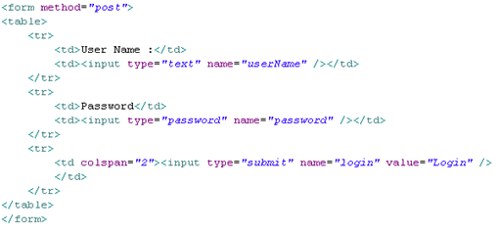
Example for jsp.setProperty usage
Option 1: <jsp:useBean id=“user” class=“com.catp.beans.User”/>
<jsp:setProperty name=“user” property=“userName” param=“userName”/>
<jsp:setProperty name=“user” property=“password” param=“password”/>
Option 2:
<jsp:useBean id=“user” class=“User”/>
<jsp:setProperty name=“user” property=“*”/>
HTML form
UserBean

Slide 39
jsp:getProperty
The getProperty action is used to retrieve the value of a given property and converts it to a string, and finally inserts it into the output.
Syntax:
<jsp:useBean id=“myName” type=“package.class” />
<jsp:getProperty name="myName" property="someProperty" />
Where,
name : Bean name same as the id specified in the usebean action
property : The bean property name whose value is to be retrieved

Slide 40
jsp:getProperty Example
Example:
<jsp:useBean id=“user” type=“com.catp.beans.UserBean” />
<jsp:getProperty name=“user" property=“userName" />
This Reads the value of the property named userName from the UserBean and prints it

Slide 41
Recap: JSP Action tags
JSP Action tags | Description
jsp:include | For including a page dynamically in a parent page.
jsp:forward | For forwarding the request to a another resource.
jsp:usebean | To reference a bean and use its properties.
jsp:setProperty | Set the value of a property referred using use bean.
jsp:getProperty | Gets the property value of a bean referred in use bean tag.
jsp:Param | Used to share parameter and its value with the page being included or forwarded.

Slide 42

Time To Reflect
Associates to quickly summarize the following before ending the session
What is a java bean?
What is the difference between action and directive include?
What is the action tag used for setting a beans property value?
What is the action tag used for forwarding the request?
What is the action tag used for including a page?
What is the action tag used for mapping HTML form elements with the bean.?

Slide 43
Lend a Hand : Action Tags
Using this demo the associates gets familiarized with the following action tags in JSP
jsp:include
jsp:param
jsp:useBean
jsp:setProperty
jsp:getProperty
jsp:forward

Slide 44
Lend a Hand - Requirement
Consider a scenario in which ABC Soft corp have approached you to create a registration form for their Employees for maintaining profile of each employee in the company.
The requirement is as slated below
There are three designation of employees
Manager
Developer
Trainee
Employees should enter details in the registration form
On successful entry the employee is forwarded to their respective home pages.

Slide 45
Lend a Hand- Requirement (Cont)
The heading of the home page will be based on the designation of the employee.
The heading should be dynamically loaded based on designation of employee.
A welcome message should be present in the home page.
Components
Registration.jsp : Registration page used by employees to register.
Success.jsp : Common Home page for all employees.
traineesHeading.jsp : Heading page for trainee’s success page.
developersHeading.jsp : Heading page for developer’s success page.
managersHeading.jsp : Heading page for manager’s success page.
Employee.java : The java bean class for storing the employee details.

Slide 46
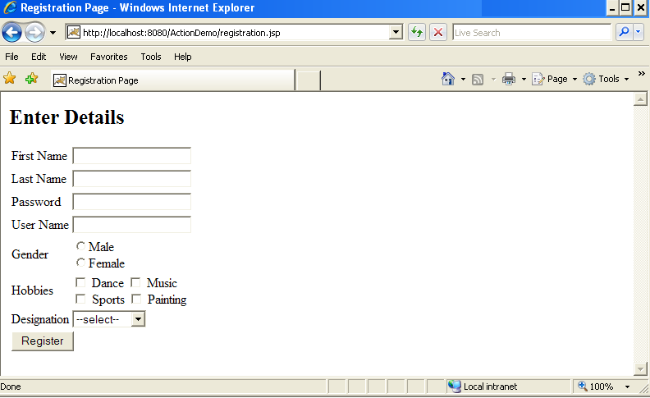
Lend a Hand : Registration page Design
Create registration page as shown below
Should have three values Manager, Trainees, Developer.

Slide 47
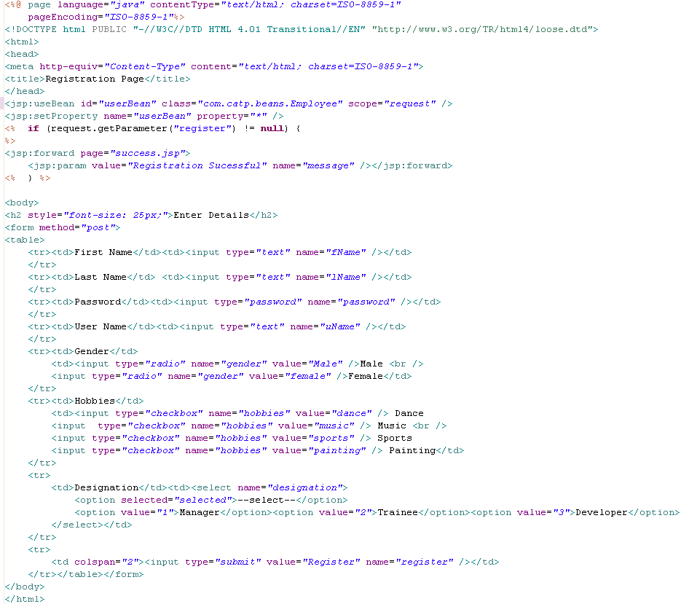
Lend a Hand : Registration.jsp code
Instantiates bean using useBean action and sets the value using setProperty action.
IMPORTANT: Ensure the name of the form elements are same as the bean property names. They are case sensitive.
Use JSP:forward to forward request to success page and jsp:param to set success message.

Slide 48
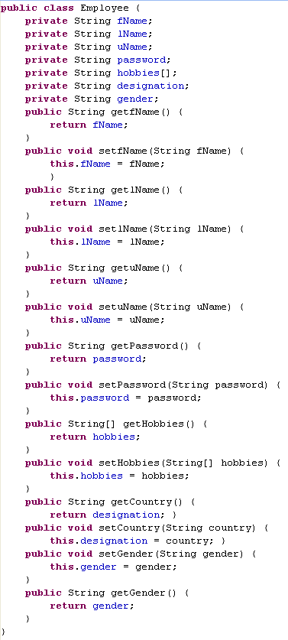
Lend a Hand – Develop User Bean

Slide 49
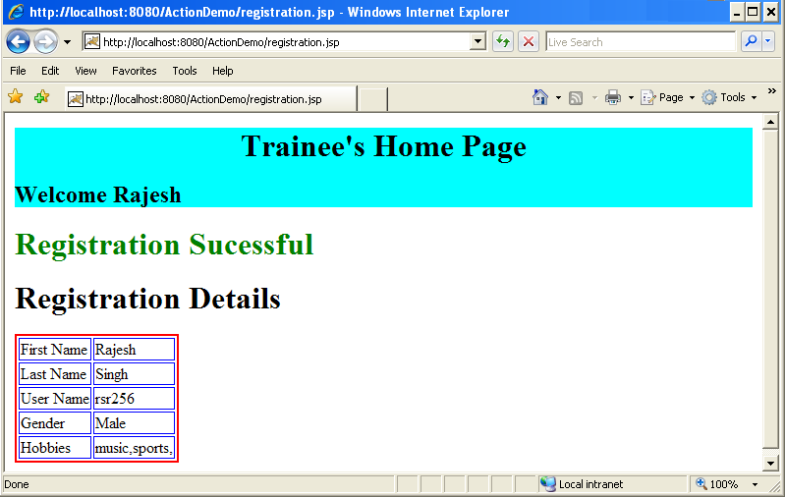
Lend a Hand- Success page Design
Create a success page which includes the header page.
The header page should be included based on the designation selected. Say “Manager Home Page”, Trainee Home Page” (or) “Developer Home Page”
The body of the success page should display all the details which the user entered in registration page in a tabular format

Slide 50
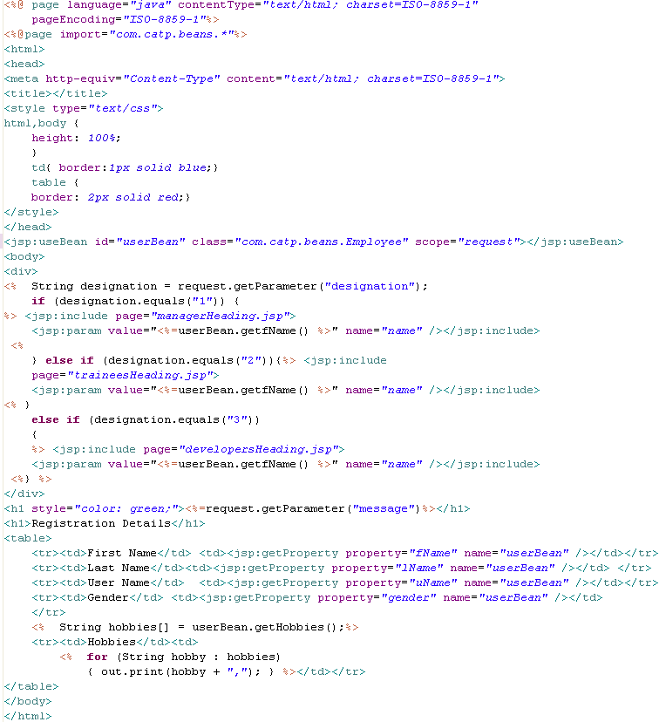
Lend a Hand - Develop success.jsp
Use JSP:include to include the respective pages and use jsp:param to set name value as a parameter for heading page to display.
Reads the value using getProperty action and prints it.

Slide 51
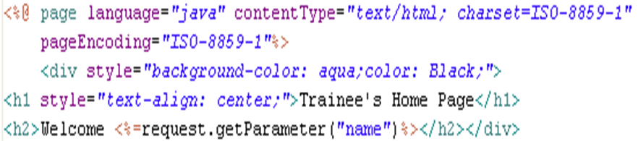
Lend a Hand – Develop traineesHeading.jsp
Access the parameter set and print the message.

Slide 52
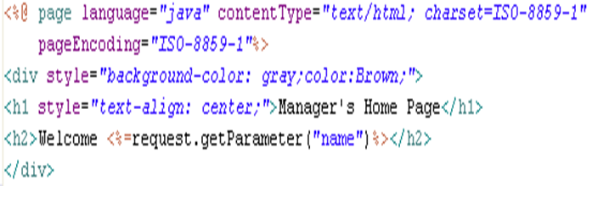
Lend a Hand – Develop managersHeading.jsp

Slide 53
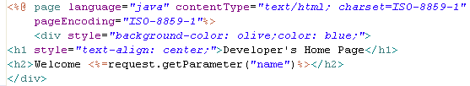
Lend a Hand – Develop developersHeading.jsp

Slide 54
Lend a Hand – Deploy and Run
Step 1 : Deploy and run the application
Step 2 : Invoke the registration.jsp from the browser
http://localhost:8080/ActionDemo/registration.jsp
Step 3 : Enter the registration details, designation as manager and click register.
Step 4 : The success page should be displayed with the manager header.
Continue step 3 and for 4 for Developer and Trainee designation. The screen should display the appropriate header pages.

Slide 55
Advance Java
You have successfully completed –
JSP Actions

